Slide 1


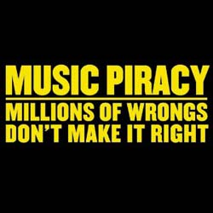

Slide 2
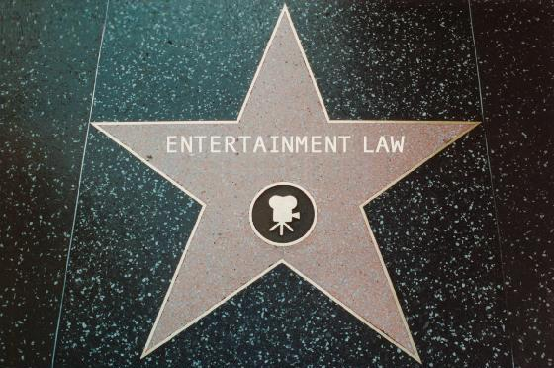
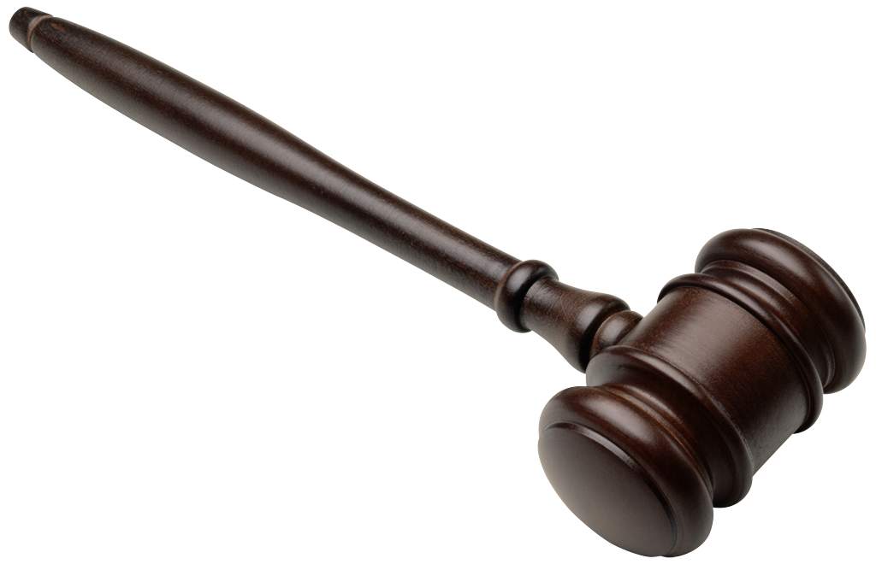
Entertainment Law:
Protecting the Rights of Famous Writers
Hope Scheckelhoff
Atholton High School
Independent Research G/T
Advisor: Stef Cassella
Justice Department Lawyer

Slide 3
Music Piracy
unauthorized reproduction or use of a copyrighted book, recording, television program, patented invention, trademarked product, etc.

Slide 4
The Rights of Writers
Copy the work
Issue copies of the work
Perform the work
Show or broadcast work to the public
Adapt the work

Slide 5
Music Theft
  Individuals who illegally upload or download music online
  Online companies who build businesses based on theft and encourage users to break the law
  Criminals manufacturing mass numbers of counterfeit CDs for sale on street corners, flea markets or at retail stores.

Slide 6
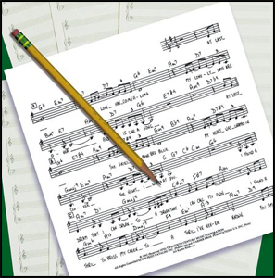
Real Life Examples
“Ice Ice Baby” by Vanilla Ice stole an unauthorized base line and melody written in David Bowie and Queen’s song “Under Pressure”
The band “The Truth Hurts” uses Bappi Lahiri’s songs without permission or credit
Notes:
example

Slide 7
If Piracy Continues…
Fewer artists will be signed by record companies
Writers will stop writing
Less music will be available to consumers

Slide 8
Taking Action…
Vice President Joe Biden tries to help end piracy
What writers can do to ensure security on their work
What schools, the media and the government should do to address the dilemma

Slide 9
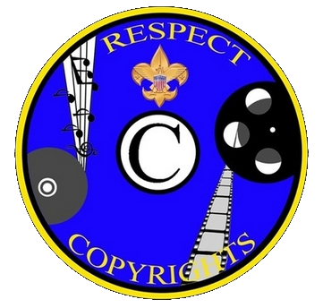


Respect the Copyrights of Songs.
Follow the Law.

Slide 10
Works Cited
Challis, Ben. “’The Song Remains The Same: A Review of the Legalities of Music Sampling.’” Music Law Updates. N.p., Dec. 2003. Web. 21 Oct. 2009.
Dames, K. Matthew. “Why the Frame of ‘Piracy’ Matters.” Information Today June 2009: 22+. Web. 9 Sept. 2009.
Litwak, Mark. “Protecting Your Stories: Borrowed Elements or Stolen Ideas?” Mark Litwak’s Entertainment Law Resources. N.p., 2003. Web. 4 Oct. 2009.
Lovette, Cliff. “Cliff Lovette: Entertainment Lawyer.” C-47. 3 July 2007. www.youtube.com. Web. 10 Oct. 2009.
Sax, Jody. “What Does Copyright Protect.” Law Girl. N.p., n.d. Web. 14 Oct. 2009.
Vance, Eric. “Protecting Intellectual Property.” Lawyers.com. N.p., 2009. Web. 5 Oct. 2009.

